Slide 1

Lecture 2: Linux Devices

Slide 2
Agenda
1
Reminder
2
Linux Devices
3
About next Assignment
Notes:
2
2
2

Slide 3
Agenda
1
Reminder
2
Linux Devices
3
About next Assignment
Notes:
3
3
3

Slide 4
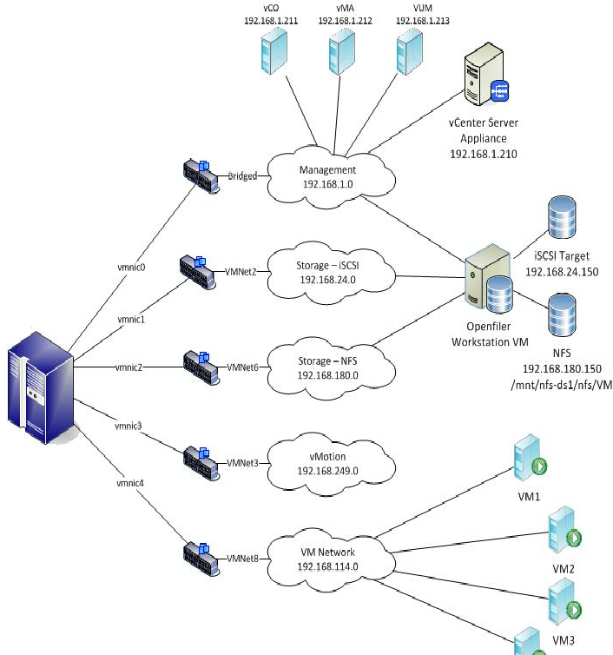
Virtual Network
You’ve all experienced setting up virtual lab with machines and networks

Slide 5
What is a Kernel Module
What is a kernel module?
An object file that contains code to extend the running kernel, or so-called base kernel, of an operating system
Kernel module can be used as a hardware device manager, or to add new software features
Since we won’t use any hardware in this workshop, we will focus on adding features

Slide 6
Linux Networking
We need a way to see the packets
Packets has headers for each layer and data
Linux contains set of useful tools and structures to manage packets over the kernel

Slide 7
Packet Headers
Each packet comes with headers, each for every layer
The layers we are interested in are the network layer and transport layer
We can use the information to decide the verdict for each packet/connection
IP header
TCP/UDP header
Data
HTTP/1.1 200 OK0x20Last-Modified: Mon, 07 Apr 2014 09:16:25
GMT0x20Content-Type: image/jpeg0x20Cache-Control:
max-age = 3153600000x20magicmarker: 10x20Content-Length:
47060x20Accept-Ranges: bytes0x20Date: Mon, 07 Apr 2014
11:35:46 GMT0x20X-Varnish: 2786274250 27578957660x20Age:
83980x20Via: 1.1 varnish0x20Connection: keep-alive0x20X-Cache:

Slide 8
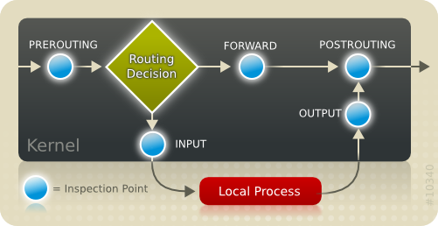
NetFilter
5 inspection points which can be used to define behaviors for each type of packets

Slide 9

Our Kernel Module – The Firewall!
What will we do with our kernel module?
Register our own functions (AKA: hooks) with the Netfilter API, to issue verdicts on packets going in/out/through our Linux box
Register a char device, to communicate with the user space
Send commands to set module values
Receive data from the firewall about the state of the system

Slide 10
Agenda
1
Reminder
2
Linux Devices
3
About next Assignment
Notes:
10
10
10

Slide 11
Devices
There are three kinds of devices in Linux:
Character devices – read/write single bytes
Examples: keyboards, printers, and most pseudo-devices
Block devices – read/write blocks of bytes
Examples: hard drives, Blu-ray discs, and memory devices such as flash
Network devices – access to internet via physical adapter
Now days Linux kernel has a unified model for all devices
The device model provides a single mechanism for representing devices and describing their topology
For further reading on kobjects, ktypes and ksets see: https://www.kernel.org/doc/Documentation/kobject.txt
We deal with more higher level objects
More information - Linux Kernel Development, page 337

Slide 12
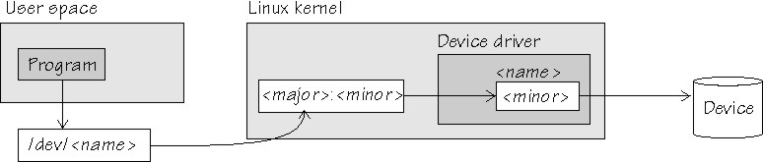
Character Devices
We access char devices via names in the file system
Located under /dev
Every char device has its major number and minor number
Major #: unique ID for each device manager
Minor #: ID for each device connected to the device manager
A device can define its own operations on its interface files

Slide 13
Add new char device
To create new char device, we need to allocate him new major#
The function register_chrdev() does it for us
Syntax:
int register_chrdev (unsigned int major, const char* name, const struct file_operations* fops);
major – major device number or 0 for dynamic allocation
minor – name of this range of devices
fops - file operations associated with this devices
Function returns 0 for success or -1 for failure

Slide 14
File Operations
After registering our char device, it’s linked to the major #
We will create a representation of it in the file system with mknod or the function device_create, if used with sysfs
Can be seen under /dev/<device_name>
The “struct file_operations (AKA: fops)” contains mainly pointers to functions
It is used to plant our own implementations to various file system calls, like opening or closing a file, and much more
First, we define and implement our functions, with the right signature
Then, we build an instance of this struct, and use it when we register our char device

Slide 15
Example
A scenario:
me@ubuntu:~$ ls -l /dev/my_device*
crw-rw-rw- 1 root root 250, 0 Aug 15 12:07 /dev/my_device1
cr--r--r-- 1 root root 250, 1 Aug 15 12:07 /dev/my_device2
me@ubuntu:~$ cat /dev/my_device2
Hello device2’s World!
The ‘cat’ called our implementations of open, read, and release(close)
We need to support these functions if it’s different from the default operation
Owner can be set also through macro: SET_MODULE_OWNER(&fops);
struct file_operations my_fops = {
.owner = THIS_MODULE,
.open = my_open_func,
.read = my_read_func,
.release = my_release_func
};

Slide 16
Remove char device
When we want to remove a device from the system (usually in the cleanup_module function) we will use unregister_chrdev()
Syntax:
unregister_chrdev(unsigned int major, const char *name)
major – the major related to the device we want to remove
name - the name of the device
Function returns 0 for success or -1 for failure

Slide 17
sysfs
A brilliant way to view the devices topology as a file system
It ties kobjects to directories and files
Enables users (in userspace) to manipulate variables in the devices
The sysfs is mounted in /sys
Our interest is by the high level class description of the devices
/sys/<CLASS_NAME>
We can create devices under this CLASS_NAME
/sys/<CLASS_NAME>/<DEVICE_NAME>
/sys/class/my_class/my_first_device/dev_att

Slide 18
Device Class
Device class is a concept introduced in recent kernel versions
Helps us maintain a logical hierarchy of devices (not to be confused with char devices!)
Every device has the char-device’s major#, and a minor# of its own
my_class
device1
device2

Slide 19
sysfs (cont)
Just as in read and write, we will have to implement input and output to the sysfs files
When we will create device files we will have to define device_attributes
Pointer to show function
Pointer to store function
We can just use
echo “whatever” > /sys/<CLASS_NAME>/<DEVICE_NAME>/store
Where is the catch?
We can only move data that is smaller than PAGE_SIZE
A convention is to use human readable data

Slide 20
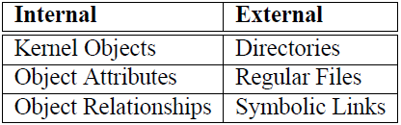
Sysfs (AKA: /sys)
To create such file:
Create read/write(show/store) functions
Create a Device Attribute for the file
Register the Device Attribute using sysfs API, under your desired device
A scenario:
me@ubuntu:~$ cat /sys/class/my_class/my_first_device/num_of_eggs
2
me@ubuntu:~$ echo spam > /sys/class/my_class/my_second_device/worm_whole

Slide 21
How to work with sysfs
First, we need to register our device
register_chrdev(unsigned int major, const char *name, struct file_operations *fops);
We will set major to 0 to let the system dynamically give us a major
Don’t forget unregister_chrdev in the exit function
Later, we will create a class to see under /sys/class
struct class * device_class = class_create (struct module *owner, const char *name);
Don’t forget class_destroy in the exit function
Owner: the module owner, usually set to the macro THIS_MODULE
Name: the name you picked for the class
The function returns struct class

Slide 22
Continue to set up the environment
After we created the class folder, we now want to put our device in it. We create device which will link our device into the class
struct device * device_create (struct class * class, struct device * parent, dev_t devt, void * drvdata, const char * fmt, ...);
Don’t forget device_destroy in the exit function
Class: the struct class that this device should be registered to, which we created.
Parent: pointer to the parent struct device of this new device, if any (usually NULL)
Devt: the dev_t for the char device to be added – we need to make a unique number for this device. We have a macro which provide us this number: MKDEV(major number, minor number)
Drvdata: the data to be added to the device for callbacks (usually NULL)
Fmt - string for the device's name

Slide 23
Continue to set up the environment
We have now put our device in the class, and we can reach it’s default attributes
We don’t care about the default, and we will usually need to implement 2 new ones (if we need them):
Show: show data to the userspace, similar to read
Store: send data to the kernel space
After implementation, we link the device with these attributes with the macro DEVICE_ATTR(name,mode,show,store)
We will use device_create_file(struct device *device, const struct device_attribute *entry); to have our new attributes in the device folder
Don’t forget device_remove_file in the exit function

Slide 24
References
Further reference:
Linux Device Drivers, Third Edition
An excellent free e-book, contains all you need and don’t need to know about kernel modules.
Written for kernel 2.6, but not a lot changed since.
Kernel Headers and Documentation
On your machine
e.g. /usr/src/linux-headers-`uname -r`/include/linux/ip.h
On the net
LXR or any other cross-reference site.
http://kernel.org/doc/Documentation/
The hardest to read, but probably the most useful.
Google, Stackoverflow, and Wikipedia has everything you need

Slide 25
Agenda
1
Reminder
2
Linux Devices
3
About next Assignment
Notes:
25
25
25

Slide 26
Assignment 2
This assignment we will continue to learn about Linux kernel features and APIs which will help us along the way
We will need to implement connection between your module and a user-space C program
Use sysfs as you learned in this lecture
Sysfs is a popular way to connect to the kernel, use the internet to help you figure out what you don’t understand
Make sure your program prints exactly what it should – no more, no less, pay attention to spaces

